Slide 1
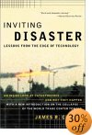
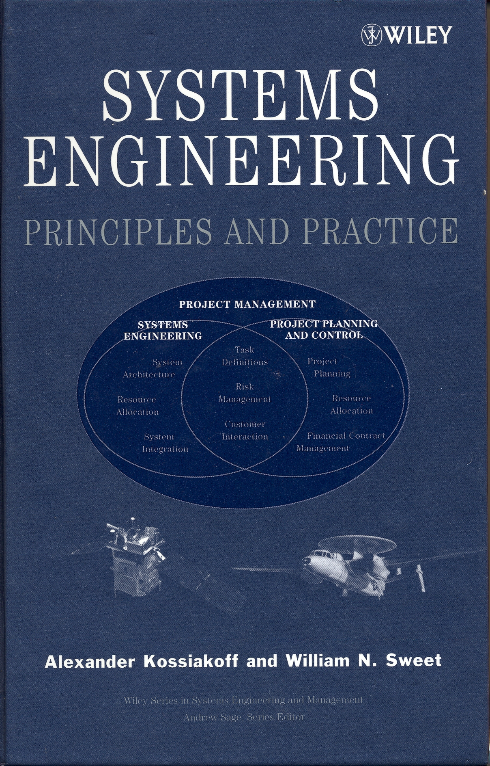

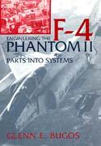
Texts for the course
Optional
Required
Required
Choose 1 of 2

Slide 2
Reading Assignments
Kossiakoff and Sweet, Systems Engineering Principle and Practice is intended as a optional reference textbook
  It takes a life cycle approach to systems engineering during systems development
  This is a classic view and useful but does not address the problems of systems engineering in operational programs
  There will not be assigned readings or problems from this book
We will work thru both the Johnson, Secrets of Apollo and the Chiles, Inviting Disaster or Bugos Engineering the F-4 book with assigned readings and questions
Even though Johnson is about NASA and Apollo, it describes in detail the evolution of military systems engineering practices discussing aircraft as well as ballistic missiles
Most mishap reports describe lack of systems engineering as a contributing factor so it is worthwhile to understand high tech catastrophes. Chiles book is an excellent review of the types of factors that cause high technology catastrophes spanning a wide range of space, aviation, energy and construction industries. Bugos is an excellent book on engineering a weapons ssystem
Readings will be assigned by certain date and you will submit answers to questions from the chapter. We will discuss the chapters in class and there will be questions from the readings on the exams

